Slide 1

Security
By: Abdallah Salhab

Slide 2
Firewall and VPN misconfiguration consequences:
*A firewall is a system that implements an access control policy between the networks.
Firewalls are configured to block harmless devices and traffic, and to give it to the allowed traffic. up to 95% of firewalls failures are due to incorrect misconfiguration.
*A VPN creates a logical connection between two end points over a public network, the confidentiality is being achieved be encrypting the data that is passing the VPN.
-The misconfiguration of the network security devices means to give unauthorized access to internal network by choosing wrong settings on the access control list.
-some times misconfiguring a firewall can block devices from inside the network to use certain websites.
-In general misconfiguring a VPN or a Firewall can create a vulnerability that hackers can use to access the data being transmitted or the network behind the Firewall which is a concern for confidentiality of the data.
Notes:
https://www.sunnyvalley.io/docs/network-security-tutorials/most-common-cause-of-firewall-failure

Slide 3
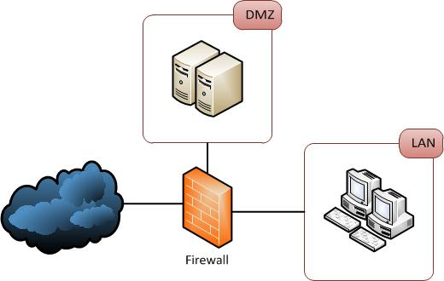
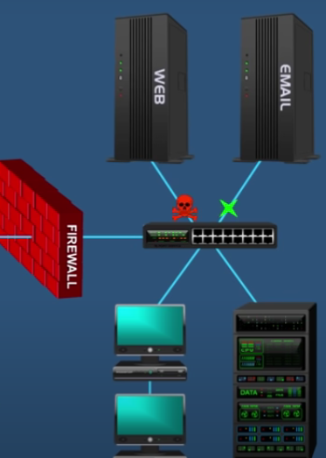
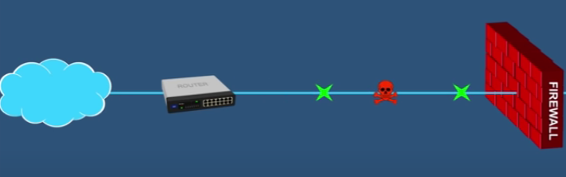
DMZ otherwise known as demilitarized zone is used to improve the organizations security by separating devices such as, the computers from the servers in the private side of the network.
DMZ is used when a company wants it’s customers to access a web or email server inside the fire wall with out the vulnerability that a hacker can use the advantage of the access inside the firewall.
The DMZ creates a separate like network that has the services servers can be accessed by users, without having access to the organizations computers and database.
Without DMZ

Slide 4
NAT (network address translation) is a service in routers that translates a set of private IP addresses to one or more public IP addresses.
IPv4 public addresses are limited, so that if every device that wants to access the internet has a public IP address we would have runout of them, so to preserve the number of public IP addresses routers give each device a private IP address, and if a device want to use the internet, the router translates the devices private IP address to the public IP address that is assigned to them, and that happens when a device wants to receive something from the network, so the router translates the destination public IP address to the device’s private IP address.
NAT can have some security advantages such as:
* the device’s private IP addresses can’t be traced from the outside so it’s harder to do an attack because they don’t have specific private IP to attack.
Notes:
https://www.checkpoint.com/cyber-hub/network-security/what-is-network-address-translation-nat/

Slide 5
Static IP addressing: a static IP address is a fixed IP, which means that it dose not change, it has a lot of advantages such as:
-it is easier for a DNS to find a static IP address
-it gives more accurate geographical location for servers that use geo-location to accurately pin point the user location.
But more importantly especially for organizations that have remote workers to connect to the organization static IP can provide them with reliable connection to the network and the network can easily identify who is accessing the network so it insures the data is secure.
Notes:
https://www.cyberghostvpn.com/en_US/privacyhub/static-vs-dynamic-ip/#:~:text=A%20static%20IP%20also%20provides,always%20after%20your%20private%20data.

Slide 6
Network monitoring: network monitoring can be used to detect any intrusion in the network and to handle them according to preconfigured rules.
The system has to have an idea on how the network normally behaves so if any thing unusual happens the system recognize it as unusual behavior, and for that the traffic has to be captured.
Most common methods to capture the traffic are:
-Network taps
-switch port analyzer(SPAN)

Slide 7
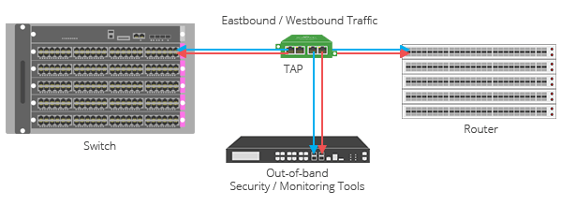
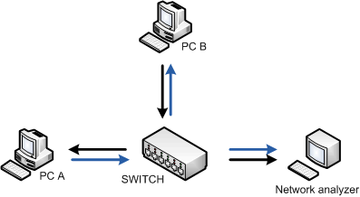
SPAN: span and taps work for the same reason but they do it in deferent ways
-to capture the traffic SPAN uses a port mirroring on a switch that copies frames form one or more ports and gives them to a switch port analyzer and the destination port is connected to a packet analyzer or a IDS.
Network TAPs:
TAPs are a splitting device that is between the devices that have to be monitored, the TAP sends all the transmitted and received data to a monitoring device (that analyses the packets) in real time and without dropping any thing, so it also give all the errors that have happened.
Or an IDS sensor
SPAN | TAPS
Requires an engineer | Easy to install
Drops the errors | Keeps all the errors
Can be hacked | Cant be hacked

Slide 8
Network monitoring tools:
-network protocol analyzer: network protocol analyzer is a software application that collects data packets swerving the network.
The analyzer can capture the data packets in the network and can determine it’s source and destination, it can be used to monitor suspicious data communication or malware.
Examples: tcpdump, wireshark.
-NetFlow:
NetFlow is a network protocol from CISCO that is used to monitor the network traffic and to collect information about the IP addresses in the network.
It can be used to detect traffic, determine it’s origin, it’s destination, it’s volume and the path on the network.
Notes:
https://www.techtarget.com/searchnetworking/definition/network-analyzer
https://blog.gigamon.com/2018/01/08/what-is-netflow/

Slide 9
Physical security: physical security is very important to protect the data in the data center and the devices that has the data, the physical security insures that the devices that has the data does not get affected by any physical threats such as vandals.
When you want to preserve the integrity of the data using physical security, the key is to not give unauthorized people to get a chance to change them and that can be accomplished by using:
1-colored badges with a photo: the colors of the badge can help the guards identify if the person is allowed to inter the area that he is in; example: red card allows him to enter the data center.
2-doors that allow only one person to pass; because even if the door has a key card reader someone could squeeze himself before the door closes.
3-CCTV connected to an alarm: if the caners detect unauthorized someone it can give an alarm that would make him unable to concentrate and the guards would get him.

Slide 10
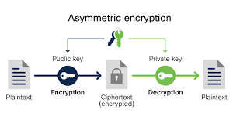
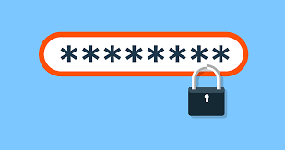
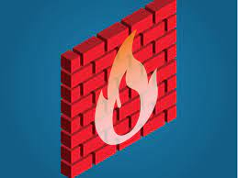
Virtual security:
1-encryption
2-strong password
3-firewall

